Slide 1
Business Intelligence G. Mudare
Notes:
Introduce yourself to the students and also find out there names
Have them give you in 30 seconds a summary of who they are and what there interest in IT is

Slide 2
Data Mining

Slide 3
Introduction
What is Data Mining
What is Needed to Do Data Mining
Business Data Mining
Data Mining Tools

Slide 4
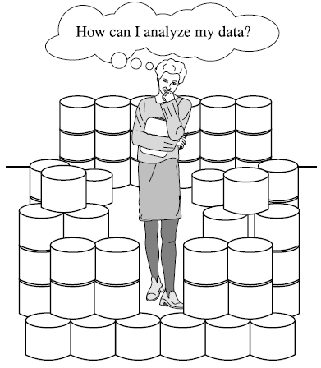
Abundance of data
The abundance of data, coupled with the need for powerful data analysis tools, has been described as a data rich but information poor situation

Slide 5
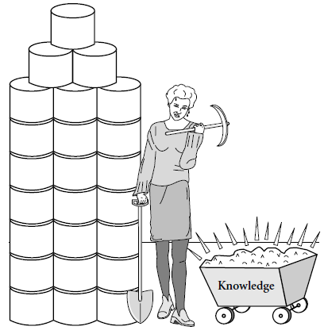
What Is Data Mining?
Data mining or KDD refers to extracting or “mining” knowledge from large amounts of data.

Slide 6
Data mining refers to the analysis of large quantities and observational data sets that are stored in computers to find unsuspected relationships and to summarize the data in novel ways that are both understandable and useful to the data owner.
Data Mining, also popularly known as Knowledge Discovery in Databases (KDD), refers to the nontrivial extraction of implicit, previously unknown and potentially useful information from data in databases.
Data mining refers to extracting or “mining” knowledge from large amounts of data

Slide 7
What Is Data Mining?
With the enormous amount of data stored in files, databases, and other repositories, it is increasingly important, if not necessary, to develop powerful means for analysis and perhaps interpretation of such data and for the extraction of interesting knowledge that could help in decision-making.

Slide 8
What Is Data Mining?
Enormous amount of data stored in
files,
databases,
other repositories,
Powerful means required for analysis and interpretation of such data and for the extraction of interesting knowledge that could help in decision-making.

Slide 9
The definitions refer to "observational data," as opposed to "experimental data."
Data mining typically deals with data that have already been collected for some purpose other than the data mining analysis
Objectives of the data mining exercise play no role in the data collection strategy.
In statistics, data are collected by using efficient strategies to answer specific questions.
Data mining is actually part of the knowledge discovery process.
The definition also mentions that the data sets examined in data mining are often large.

Slide 10
Problems That Arise With Large Amounts Of Data
When we are faced with large bodies of data, new problems arise.
housekeeping issues of how to store or access the data,
how to determine the representativeness of the data
how to analyse the data in a reasonable period of time
how to decide whether an apparent relationship is merely a chance occurrence not reflecting any underlying reality.
Often the available data comprise only a sample from the complete population (or, perhaps, from a hypothetical super population);
the aim may be to generalize from the sample to the

Slide 11
Knowledge Discovery process
Steps 1 to 4 are different forms of data pre-processing, where the data are prepared for mining.
The data mining step may interact with the user or a knowledge base.
The interesting patterns are presented to the user and may be stored as new knowledge in the knowledge base.
Note that according to this view, data mining is only one step in the entire process, albeit an essential one because it uncovers hidden patterns for evaluation.

Slide 12
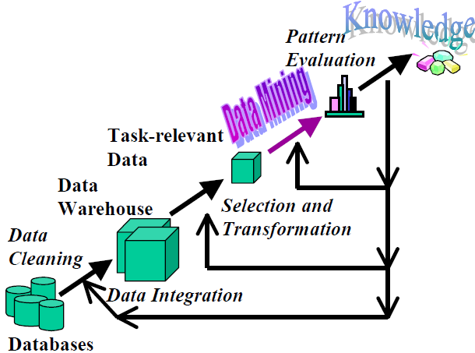
Data Mining is the core of Knowledge Discovery process

Slide 13
Major Components
Database, data warehouse,WorldWideWeb, or other information repository:
Data cleaning and data integration techniques may be performed on the data.
Database or data warehouse server: The database or data warehouse server is responsible for fetching the relevant data, based on the user’s data mining request.
Knowledge base: This is the domain knowledge that is used to guide the search or evaluate the interestingness of resulting patterns
Data mining engine: This is essential to the data mining system and ideally consists of a set of functional modules for tasks such as characterization, association and correlation analysis, classification, prediction, cluster analysis, outlier analysis, and evolution analysis.
Pattern evaluation module: This component typically employs interestingness measures and interacts with the data mining modules so as to focus the search toward interesting patterns.
User interface:this component allows the user to browse database and data warehouse schemas or data structures, evaluate mined patterns, and visualize the patterns in different forms.

Slide 14
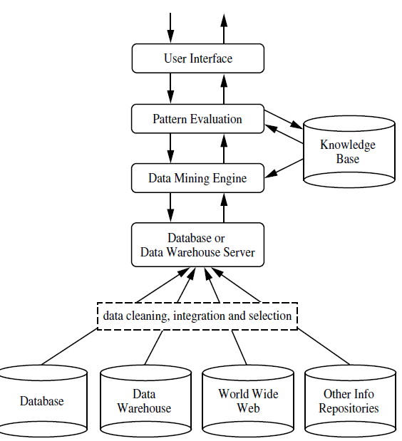
Architecture of a typical data mining system.

Slide 15
Data Mining—On What Kind of Data
In principle, data mining should be applicable to any kind of data repository, as well as to transient data, such as data streams
Data repositories:
relational databases,
data warehouses,
transactional databases,
advanced database systems (object Relational),
flat files,
data streams,
World Wide Web
specific application-oriented databases, such as spatial databases, time-series databases, text databases, and multimedia databases.

Slide 16
Data Mining Functionalities What Kinds of Patterns Can Be Mined?
Concept/Class Description: Characterization and Discrimination : summarizing the data of the class under study
Mining Frequent Patterns, Associations, and Correlations:
Patterns that occur frequently in data.
Classification and Prediction
use the model to predict the class of objects whose class label is unknown.
Cluster Analysis: organization of data in classes
Outlier Analysis: data elements that cannot be grouped in a given class or cluster. (exceptions or surprises)
Evolution Analysis: describes and models regularities or trends for objects whose behaviour changes over time

